Slide 1
HMM Details

Slide 2
AGENDA
HMM Basics
Types of HMM
Three fundamental problems
Solution to Problem 1 (Testing)
Solution to Problem 2
Solution to Problem 3 (Training)
Speech Recognition

Slide 3
HMM Basics

Slide 4
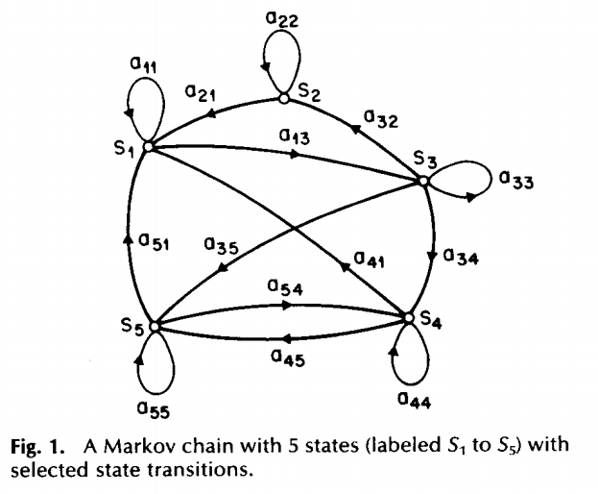

State Transition Matrix (A)

Slide 5
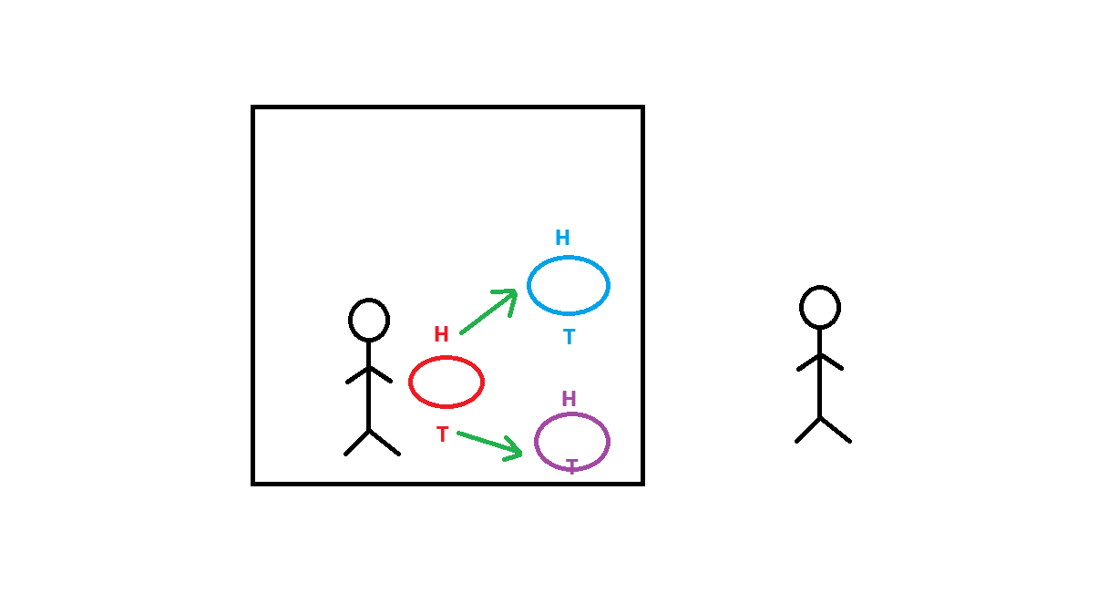
Hidden process (3 Coins)

Slide 6
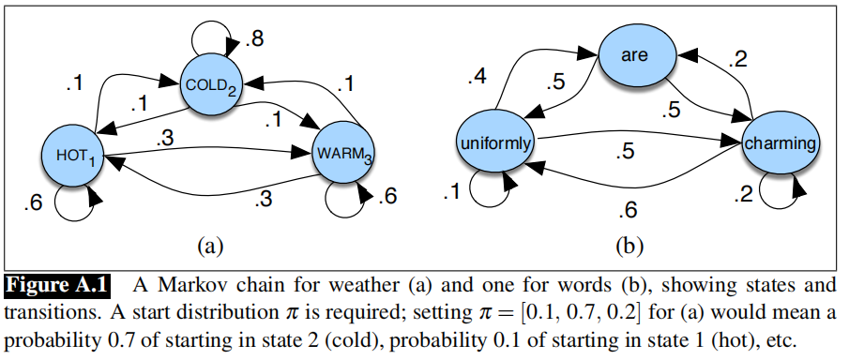

Slide 7
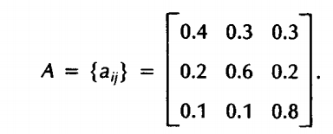
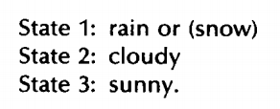
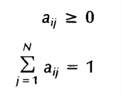

Slide 8
Types of HMM

Slide 9
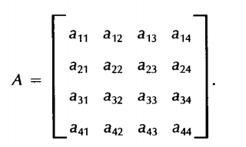
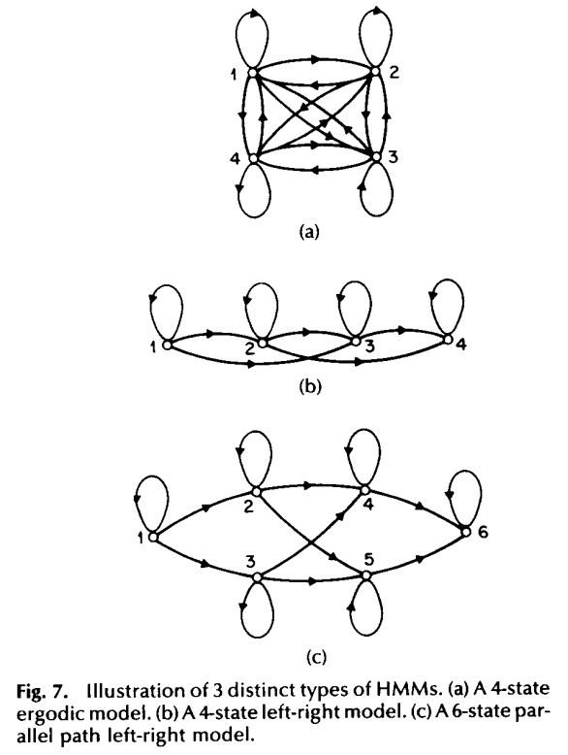
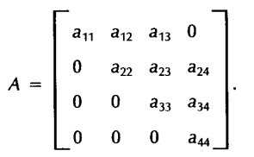
Types of HMM

Slide 10
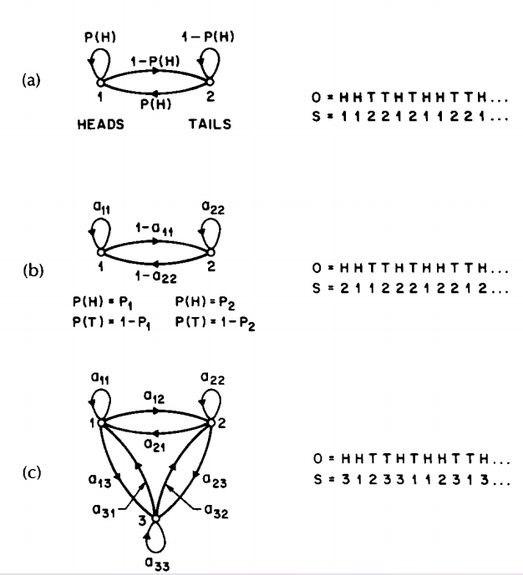

Slide 11
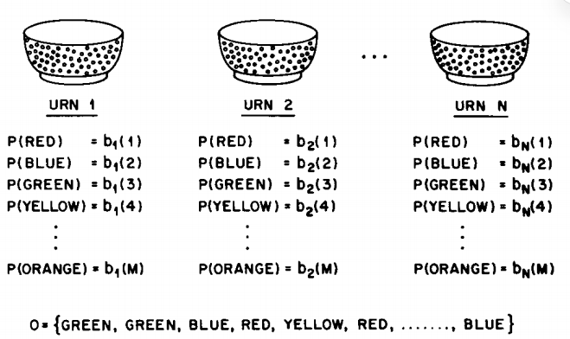

Slide 12
Three fundamental problems

Slide 13
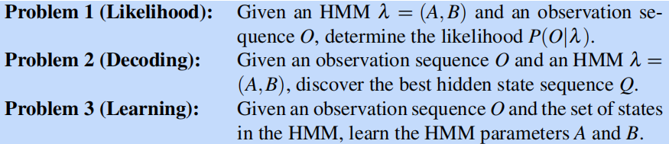
Three fundamental problems

Slide 14
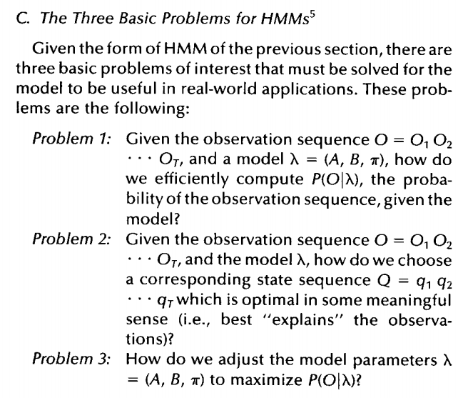
Three fundamental problems

Slide 15
Solution to Problem 1

Slide 16
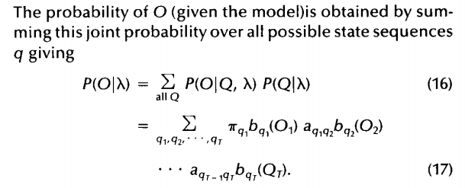
Solution to Problem 1: Exhaustive search

Slide 17
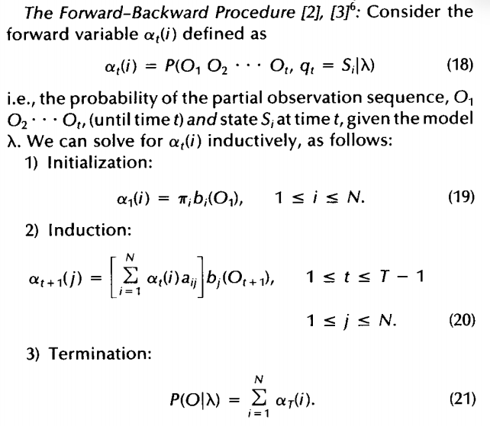
Forward Algorithm

Slide 18
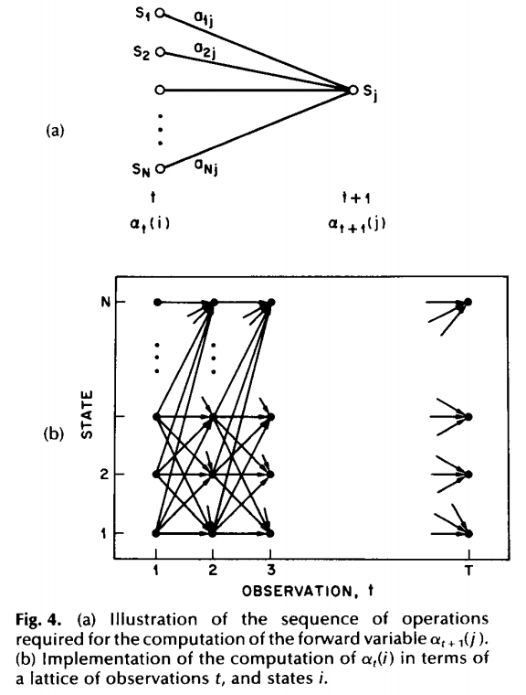
Forward Algorithm

Slide 19
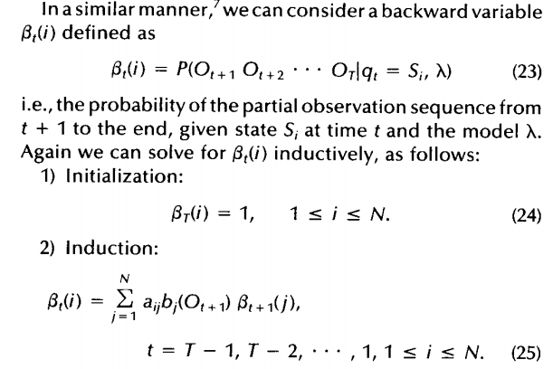
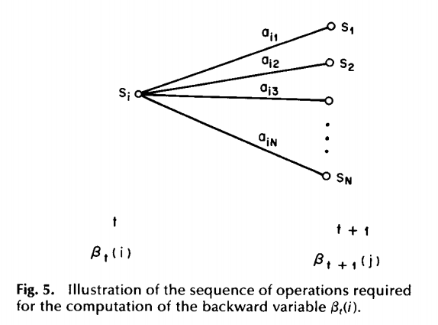
Backward Algorithm

Slide 20
Solution to Problem 2

Slide 21
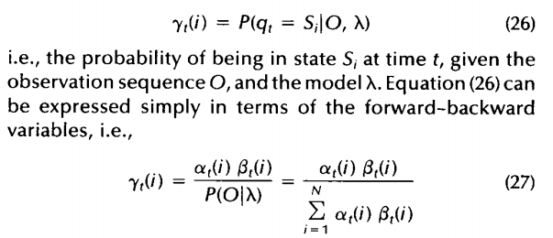
Solution to Problem 2

Slide 22
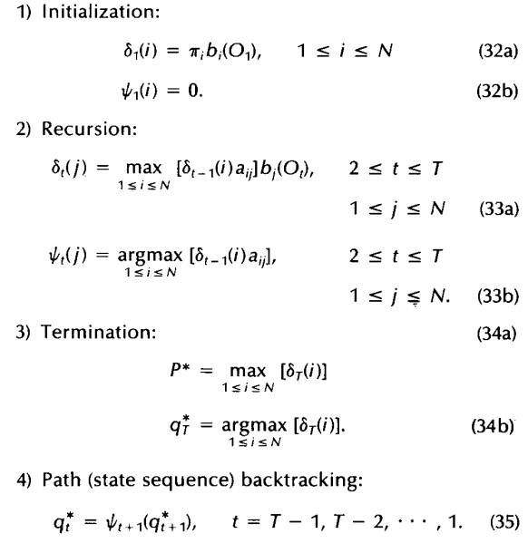
Viterbi Algorithm

Slide 23
Solution to Problem 3

Slide 24
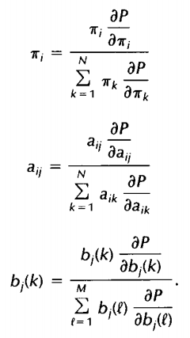

Solution to Problem 3
Expectation Maximization (EM)

Slide 25
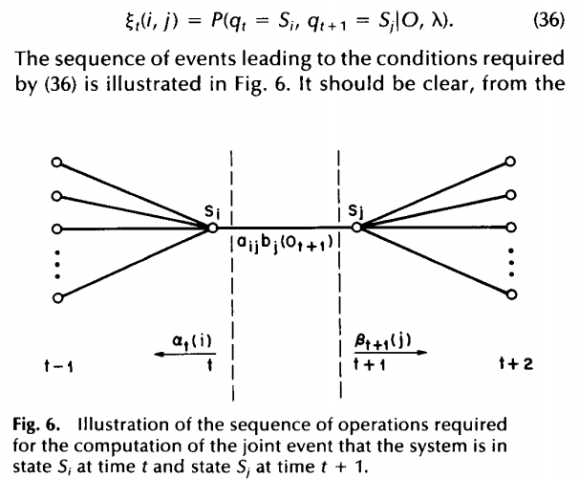
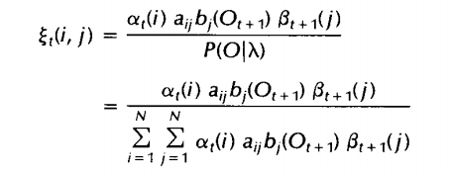
Solution to Problem 3

Slide 27
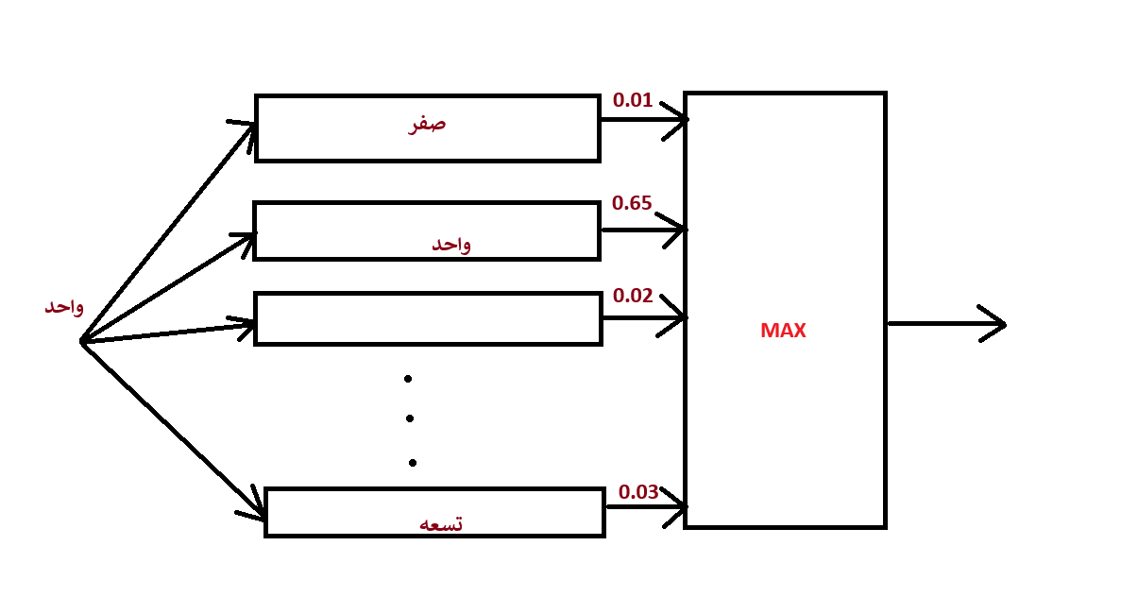
Testing of Speech Recognition system

Slide 28
THANK YOU
Prof. Alaa Hamdy

